Slide 1
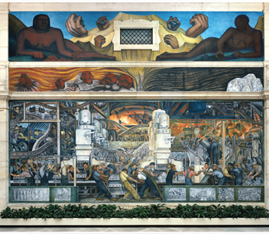
PEOPLE,
POWER,
AND PAY
THE ECONOMICS OF THE WORKPLACE
SIMON D. HALLIDAY
FALL 2026
Notes:
[Sources]
- Source content: /Users/shalliday/github/people-power-pay/private/Slides/Week01/week01_slides.pptx, source slide 1.
- Design reference: /Users/shalliday/github/people-power-pay/assets/css/ppp-rivera-v2.css and /Users/shalliday/github/people-power-pay/assets/css/quarto-nav-rivera-v1.css.
- Artwork: Diego Rivera, Detroit Industry Murals, 1932–33; local course asset /Users/shalliday/github/people-power-pay/assets/images/rivera-detroit-industry.png.
[/Sources]

Slide 2
Think about the workplace
OPEN THE BLACK BOX
What have you previously learned about the economics of the workplace and work? Ask the person next to you.
What are you curious about understanding about the economics of the workplace?
What aspects about your future workplace concern you or are you excited about?
02
Notes:
[Sources]
- Source content: /Users/shalliday/github/people-power-pay/private/Slides/Week01/week01_slides.pptx, source slide 2.
- Design reference: /Users/shalliday/github/people-power-pay/assets/css/ppp-rivera-v2.css and /Users/shalliday/github/people-power-pay/assets/css/quarto-nav-rivera-v1.css.
[/Sources]

Slide 3
Think back in time
OPEN THE BLACK BOX
What tools from economics do you think we can apply to the workplace?
What tools have you learned in other disciplines do you think might apply to the workplace?
03
Notes:
[Sources]
- Source content: /Users/shalliday/github/people-power-pay/private/Slides/Week01/week01_slides.pptx, source slide 3.
- Design reference: /Users/shalliday/github/people-power-pay/assets/css/ppp-rivera-v2.css and /Users/shalliday/github/people-power-pay/assets/css/quarto-nav-rivera-v1.css.
[/Sources]

Slide 4
WE NEED A THEORY OF ORGANIZATION
01
Notes:
[Sources]
- Source content: /Users/shalliday/github/people-power-pay/private/Slides/Week01/week01_slides.pptx, source slide 4.
- Design reference: /Users/shalliday/github/people-power-pay/assets/css/ppp-rivera-v2.css and /Users/shalliday/github/people-power-pay/assets/css/quarto-nav-rivera-v1.css.
[/Sources]

Slide 5
Outline
OPEN THE BLACK BOX
Revise basics of (Neoclassical) economic theory
Identify the problem of the ‘black box’ of production and the market
Assess how different methods of social and economic organization affect economic outcomes.
Show that transactions, transactions costs, and incomplete contracts pervade economic analysis—these are all about external effects (costs and benefits)
Examine how institutions as ‘rules of the game’ affect how people transact
05
Notes:
[Sources]
- Source content: /Users/shalliday/github/people-power-pay/private/Slides/Week01/week01_slides.pptx, source slide 5.
- Design reference: /Users/shalliday/github/people-power-pay/assets/css/ppp-rivera-v2.css and /Users/shalliday/github/people-power-pay/assets/css/quarto-nav-rivera-v1.css.
[/Sources]

Slide 6
What do firms do?
OPEN THE BLACK BOX
Try to remember what “firms” did in intro micro/macro.
What were the relevant variables?
What did they care about? Why?
06
Notes:
[Sources]
- Source content: /Users/shalliday/github/people-power-pay/private/Slides/Week01/week01_slides.pptx, source slide 6.
- Design reference: /Users/shalliday/github/people-power-pay/assets/css/ppp-rivera-v2.css and /Users/shalliday/github/people-power-pay/assets/css/quarto-nav-rivera-v1.css.
[/Sources]

Slide 7
What do firms do?
OPEN THE BLACK BOX
The owners of firms (aka or “firms”) want to maximize profits
Firms use inputs (hours of worker effort, material goods and machines) to produce outputs that are sold at market prices
Firms find the quantity and price combination that maximize their profits
Operationally, you were probably taught to find “MR = MC”
In courses using calculus, you find the profit function, impose first order conditions, and find the quantity or price that maximizes profits
Or you find the quantity that minimizes costs given an output constraint
07
Notes:
[Sources]
- Source content: /Users/shalliday/github/people-power-pay/private/Slides/Week01/week01_slides.pptx, source slide 7.
- Design reference: /Users/shalliday/github/people-power-pay/assets/css/ppp-rivera-v2.css and /Users/shalliday/github/people-power-pay/assets/css/quarto-nav-rivera-v1.css.
[/Sources]

Slide 8

Why might we say production or “the firm” is a “black box”?
OPEN THE BLACK BOX
Think back to your economics classes.
In what ways is production a “black box”?
08
Notes:
[Sources]
- Source content: /Users/shalliday/github/people-power-pay/private/Slides/Week01/week01_slides.pptx, source slide 8.
- Design reference: /Users/shalliday/github/people-power-pay/assets/css/ppp-rivera-v2.css and /Users/shalliday/github/people-power-pay/assets/css/quarto-nav-rivera-v1.css.
[/Sources]

Slide 9
Why might we say production or “the firm” is a “black box”?
OPEN THE BLACK BOX
When we use a production function, we assume that the inputs somehow translate into output, some quantity, x
There’s no hierarchy, no interaction, no employee-manager relationship just...
… x = f(k, l)
09
Notes:
[Sources]
- Source content: /Users/shalliday/github/people-power-pay/private/Slides/Week01/week01_slides.pptx, source slide 9.
- Design reference: /Users/shalliday/github/people-power-pay/assets/css/ppp-rivera-v2.css and /Users/shalliday/github/people-power-pay/assets/css/quarto-nav-rivera-v1.css.
[/Sources]

Slide 10
Issues with the black box
OPEN THE BLACK BOX
Assumes “complete contracts”
Assumes organization doesn’t matter (in a world of complete contracts and perfect competition, it doesn’t).
But in the real world…
10
Notes:
[Sources]
- Source content: /Users/shalliday/github/people-power-pay/private/Slides/Week01/week01_slides.pptx, source slide 10.
- Design reference: /Users/shalliday/github/people-power-pay/assets/css/ppp-rivera-v2.css and /Users/shalliday/github/people-power-pay/assets/css/quarto-nav-rivera-v1.css.
[/Sources]

Slide 11
Do organization and structure matter?
OPEN THE BLACK BOX
Organization structure affects…
performance and profit
motivation and incentives
planning or decentralization
Can you think of examples of any of these?
Why do you think they are important?
11
Notes:
[Sources]
- Source content: /Users/shalliday/github/people-power-pay/private/Slides/Week01/week01_slides.pptx, source slide 11.
- Design reference: /Users/shalliday/github/people-power-pay/assets/css/ppp-rivera-v2.css and /Users/shalliday/github/people-power-pay/assets/css/quarto-nav-rivera-v1.css.
[/Sources]

Slide 12
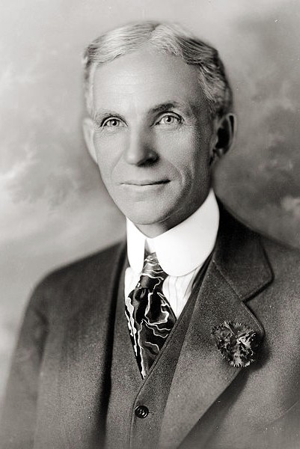
Henry Ford
ORGANIZATION CHANGES OUTCOMES
5 Jan 1914, Henry Ford implemented the $5 day
  Significant increase in pay
  Shortened the work-day to 8 hours
Several hundred workers wanted jobs at Ford, and thousands more tried to get jobs afterwards
The year after the announcement, employment had grown by one-third, and the number quitting had fallen to one-tenth of its earlier level.
Only 27 workers had been fired.
12
Notes:
[Sources]
- Source content: /Users/shalliday/github/people-power-pay/private/Slides/Week01/week01_slides.pptx, source slide 12.
- Design reference: /Users/shalliday/github/people-power-pay/assets/css/ppp-rivera-v2.css and /Users/shalliday/github/people-power-pay/assets/css/quarto-nav-rivera-v1.css.
[/Sources]

Slide 13
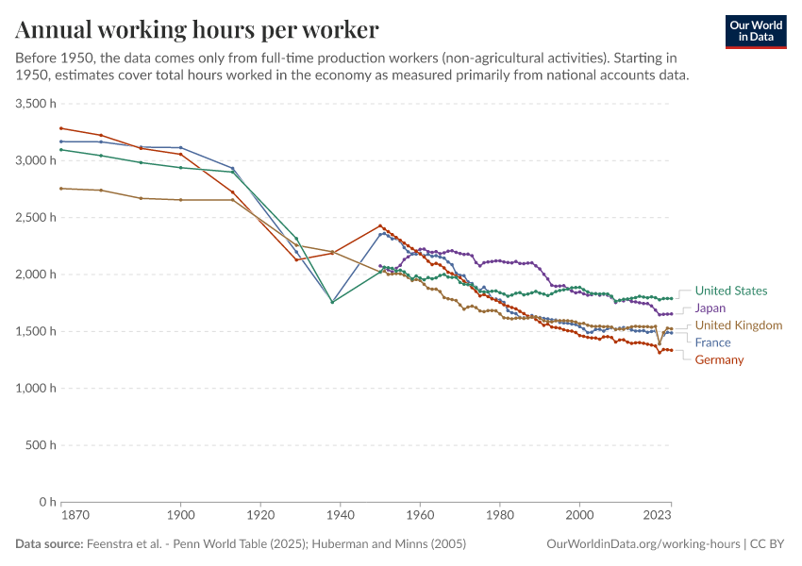
Working time fell as industrial organization changed
EVIDENCE / OUR WORLD IN DATA
Across five industrial economies, annual hours per worker fell sharply over the long run.
Ford’s eight-hour day belongs to a broader transformation in how firms organized work.
Notes:
[Sources]
- Source content: /Users/shalliday/github/people-power-pay/private/Slides/Week01/week01_slides.pptx, source slide 13.
- Design reference: /Users/shalliday/github/people-power-pay/assets/css/ppp-rivera-v2.css and /Users/shalliday/github/people-power-pay/assets/css/quarto-nav-rivera-v1.css.
- Chart: https://ourworldindata.org/grapher/annual-working-hours-per-worker.
- Data source: Feenstra et al., Penn World Table 11.0 (2025); Huberman and Minns (2005); processed by Our World in Data.
[/Sources]

Slide 14
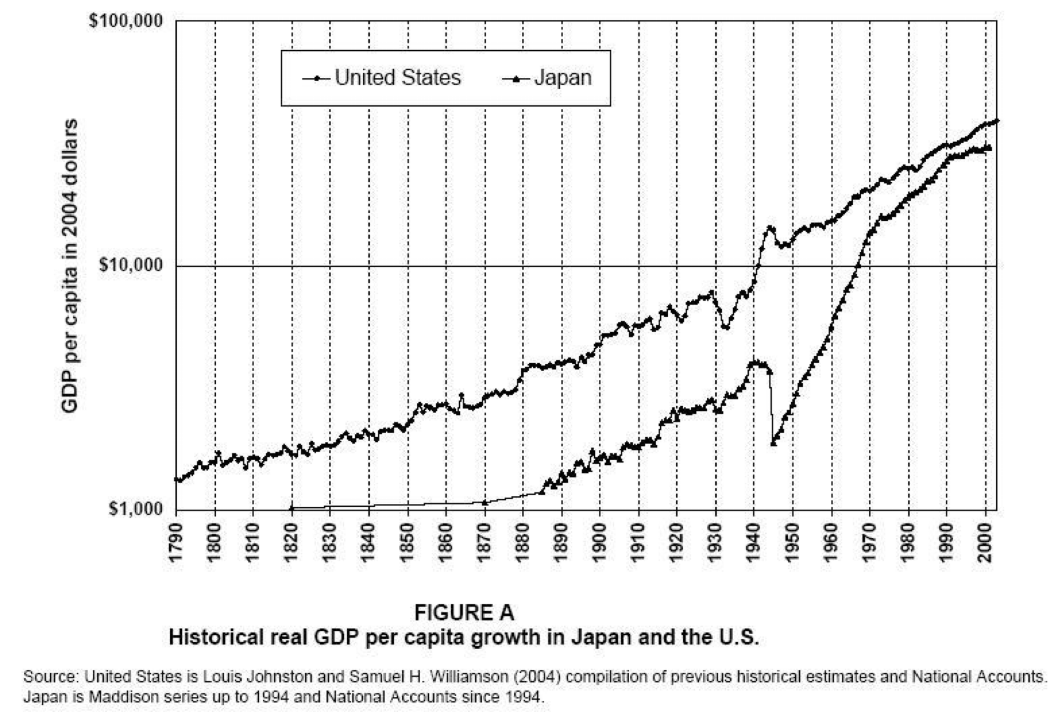
Toyota and Japanese re-industrialization
ORGANIZATION CHANGES OUTCOMES
Though Japan had begun to industrialize in the C19th, after WWII it needed to replace its industrial capacity
Japanese companies also wanted to modernize and produce American-style goods, like cars
Toyota was one of the companies that wanted to replicate what Ford did.
14
Notes:
[Sources]
- Source content: /Users/shalliday/github/people-power-pay/private/Slides/Week01/week01_slides.pptx, source slide 13.
- Design reference: /Users/shalliday/github/people-power-pay/assets/css/ppp-rivera-v2.css and /Users/shalliday/github/people-power-pay/assets/css/quarto-nav-rivera-v1.css.
[/Sources]

Slide 15
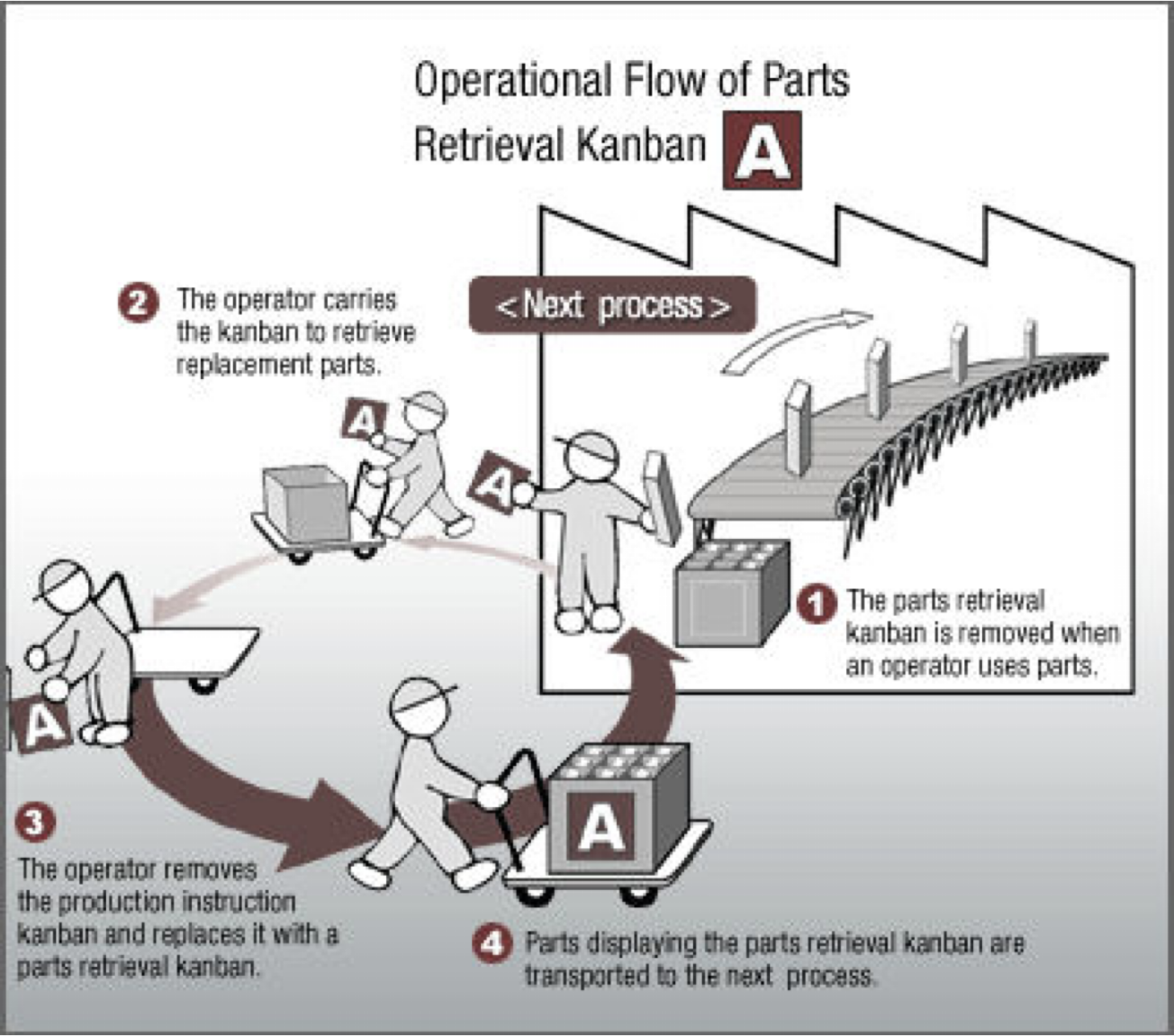
Toyota’s problem and solution
ORGANIZATION CHANGES OUTCOMES
The owners toured the US.
Toyota couldn’t match the supply mechanisms of Ford
They innovated in organization
Adopted the kanban (or ”signboard”) and “Just-in-time” (JIT) system
15
Notes:
[Sources]
- Source content: /Users/shalliday/github/people-power-pay/private/Slides/Week01/week01_slides.pptx, source slide 14.
- Design reference: /Users/shalliday/github/people-power-pay/assets/css/ppp-rivera-v2.css and /Users/shalliday/github/people-power-pay/assets/css/quarto-nav-rivera-v1.css.
[/Sources]

Slide 16
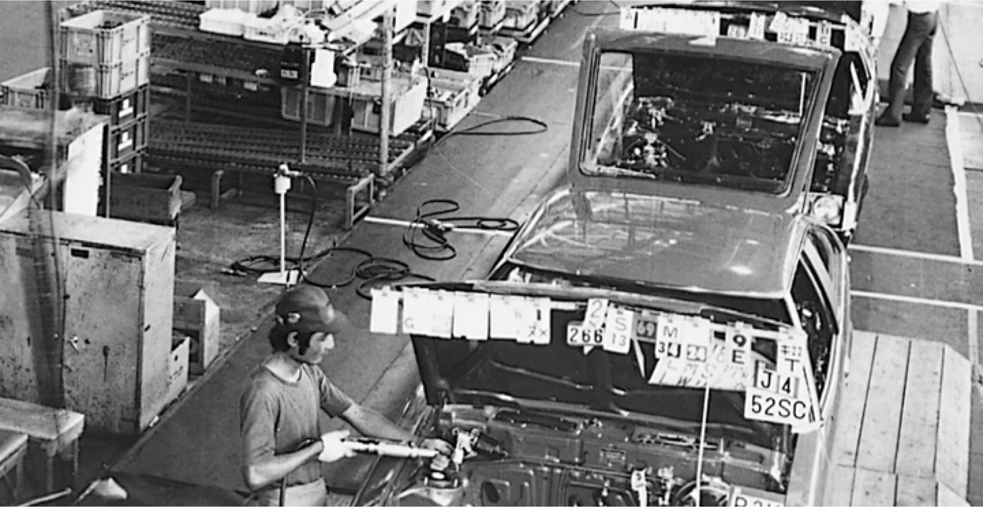
A worker at Toyota showing the kanban system in operation
ORGANIZATION CHANGES OUTCOMES
16
Notes:
[Sources]
- Source content: /Users/shalliday/github/people-power-pay/private/Slides/Week01/week01_slides.pptx, source slide 15.
- Design reference: /Users/shalliday/github/people-power-pay/assets/css/ppp-rivera-v2.css and /Users/shalliday/github/people-power-pay/assets/css/quarto-nav-rivera-v1.css.
[/Sources]

Slide 17
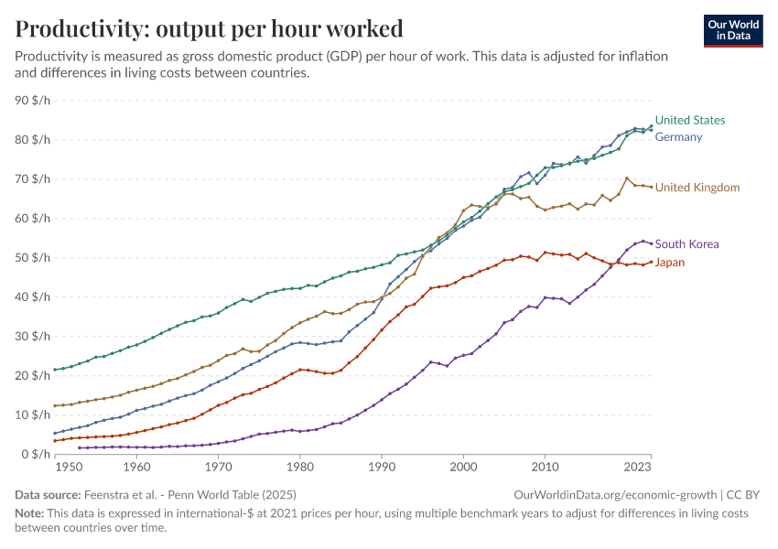
Productivity depends on more than hours worked
EVIDENCE / OUR WORLD IN DATA
Output per hour rose across these economies, with different paths and speeds.
Technology matters. So do management, coordination, skills, and institutions.
Notes:
[Sources]
- Source content: /Users/shalliday/github/people-power-pay/private/Slides/Week01/week01_slides.pptx, source slide 13.
- Design reference: /Users/shalliday/github/people-power-pay/assets/css/ppp-rivera-v2.css and /Users/shalliday/github/people-power-pay/assets/css/quarto-nav-rivera-v1.css.
- Chart: https://ourworldindata.org/grapher/labor-productivity-per-hour-pennworldtable.
- Data source: Feenstra et al., Penn World Table 11.0 (2025); processed by Our World in Data.
[/Sources]

Slide 18
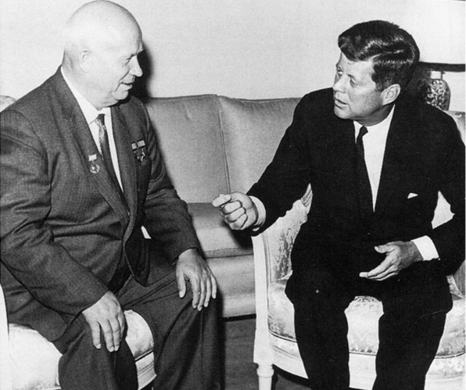
Communism and Capitalism?
MOTIVATION + COORDINATION
Different systems of economic organization
Who are these two people?
18
Notes:
[Sources]
- Source content: /Users/shalliday/github/people-power-pay/private/Slides/Week01/week01_slides.pptx, source slide 16.
- Design reference: /Users/shalliday/github/people-power-pay/assets/css/ppp-rivera-v2.css and /Users/shalliday/github/people-power-pay/assets/css/quarto-nav-rivera-v1.css.
[/Sources]

Slide 19
Economic systems allocate authority differently
MOTIVATION + COORDINATION
Central planning moves information and major production decisions toward the state.
Markets distribute many decisions among owners, workers, and firms.
Both systems must coordinate specialized activity and motivate people to carry out the plan.
Outcomes depend on property rights, information flows, incentives, and enforcement—not labels alone.
19
Notes:
[Sources]
- Source content: /Users/shalliday/github/people-power-pay/private/Slides/Week01/week01_slides.pptx, source slide 20.
- Design reference: /Users/shalliday/github/people-power-pay/assets/css/ppp-rivera-v2.css and /Users/shalliday/github/people-power-pay/assets/css/quarto-nav-rivera-v1.css.
[/Sources]
[Sources]
- Milgrom, Paul, and John Roberts. Economics, Organization and Management, chapters 1–2, reproduced in AS.197.327 Week 1 Course Pack.
[/Sources]

Slide 20

The ratchet effect rewards concealment
MOTIVATION + COORDINATION
Planners set output targets with incomplete knowledge of factory capacity.
Exceeding today’s target raises tomorrow’s target.
Managers respond by holding back effort, hoarding inputs, and understating capability.
Distorted incentives generate distorted information—and weaken coordination.
20
Notes:
[Sources]
- Source content: /Users/shalliday/github/people-power-pay/private/Slides/Week01/week01_slides.pptx, source slide 21.
- Design reference: /Users/shalliday/github/people-power-pay/assets/css/ppp-rivera-v2.css and /Users/shalliday/github/people-power-pay/assets/css/quarto-nav-rivera-v1.css.
[/Sources]
[Sources]
- Milgrom, Paul, and John Roberts. Economics, Organization and Management, chapters 1–2, reproduced in AS.197.327 Week 1 Course Pack.
[/Sources]

Slide 21
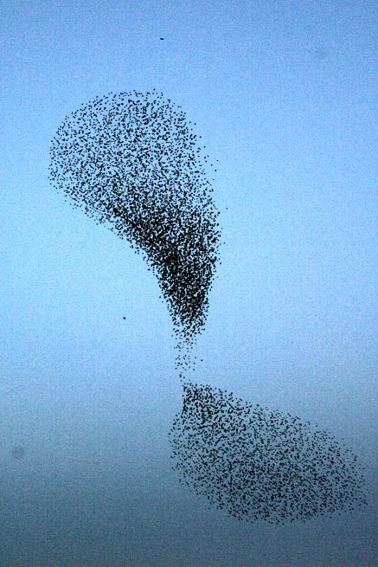
Every organization must coordinate and motivate
MOTIVATION + COORDINATION
Coordination creates a coherent plan from specialized actions and dispersed information.
Motivation induces people to follow the plan and honor commitments.
Organizations combine prices, authority, routines, incentives, and norms in different ways.
21
Notes:
[Sources]
- Source content: /Users/shalliday/github/people-power-pay/private/Slides/Week01/week01_slides.pptx, source slide 22.
- Design reference: /Users/shalliday/github/people-power-pay/assets/css/ppp-rivera-v2.css and /Users/shalliday/github/people-power-pay/assets/css/quarto-nav-rivera-v1.css.
[/Sources]
[Sources]
- Milgrom, Paul, and John Roberts. Economics, Organization and Management, chapters 1–2, reproduced in AS.197.327 Week 1 Course Pack.
[/Sources]

Slide 22
Organizational choices work as a system
MOTIVATION + COORDINATION
Put decision authority near the people with relevant information.
Align incentives with the initiative that delegation requires.
Build accounting and communication systems that make performance visible.
Fit the structure to strategy and production technology.
Toyota’s low inventories worked because reliability, supplier coordination, flexible equipment, and rapid problem-solving reinforced one another.
22
Notes:
[Sources]
- Source content: /Users/shalliday/github/people-power-pay/private/Slides/Week01/week01_slides.pptx, source slide 24.
- Design reference: /Users/shalliday/github/people-power-pay/assets/css/ppp-rivera-v2.css and /Users/shalliday/github/people-power-pay/assets/css/quarto-nav-rivera-v1.css.
[/Sources]
[Sources]
- Milgrom, Paul, and John Roberts. Economics, Organization and Management, chapters 1–2, reproduced in AS.197.327 Week 1 Course Pack.
[/Sources]

Slide 23
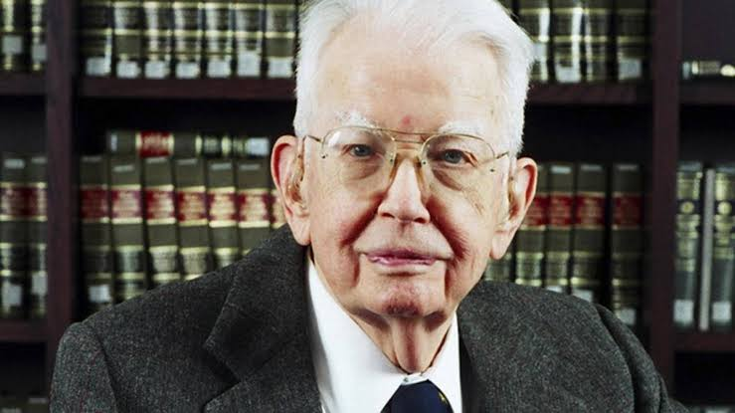
Firms replace some prices with authority
MOTIVATION + COORDINATION
“As D. H. Robertson points out, we find “islands of conscious power in this ocean of unconscious co-operation like lumps of butter coagulating in a pail of buttermilk.”1 But in view of the fact that it is usually argued that co-ordination will be done by the price mechanism, why is such organisation necessary? Why are there these “islands of conscious power”? Outside the firm, price movements direct production, which is co-ordinated through a series of exchange transactions on the market. Within a firm, these market transactions are eliminated and in place of the complicated market structure with exchange transactions is substituted the entrepreneur-co-ordinator, who directs production.”
Ronald Coase, 1937, The Nature of the Firm
23
Notes:
[Sources]
- Source content: /Users/shalliday/github/people-power-pay/private/Slides/Week01/week01_slides.pptx, source slide 25.
- Design reference: /Users/shalliday/github/people-power-pay/assets/css/ppp-rivera-v2.css and /Users/shalliday/github/people-power-pay/assets/css/quarto-nav-rivera-v1.css.
[/Sources]

Slide 24
Firms combine contracts and decision rights
CONTRACTS + DECISION RIGHTS
Firms sign binding contracts with workers, suppliers, investors, and customers.
Contracts cannot specify every future contingency.
Architecture allocates information, responsibilities, decision rights, and control.
Routines and norms guide action where formal terms end.
Intervention rights and decision discretion mark the organization’s boundary.
24
Notes:
[Sources]
- Source content: /Users/shalliday/github/people-power-pay/private/Slides/Week01/week01_slides.pptx, source slide 35.
- Design reference: /Users/shalliday/github/people-power-pay/assets/css/ppp-rivera-v2.css and /Users/shalliday/github/people-power-pay/assets/css/quarto-nav-rivera-v1.css.
[/Sources]
[Sources]
- Milgrom, Paul, and John Roberts. Economics, Organization and Management, chapters 1–2, reproduced in AS.197.327 Week 1 Course Pack.
[/Sources]

Slide 25
Transactions are the unit of analysis
TRANSACTIONS + INSTITUTIONS
A transaction transfers a good or service between people or organizations.
Carrying it out consumes resources: searching, measuring, negotiating, monitoring, and enforcing.
Transactions occur across markets and inside organizations.
Governance choices compare the full costs of feasible arrangements.
25
Notes:
[Sources]
- Source content: /Users/shalliday/github/people-power-pay/private/Slides/Week01/week01_slides.pptx, source slide 26.
- Design reference: /Users/shalliday/github/people-power-pay/assets/css/ppp-rivera-v2.css and /Users/shalliday/github/people-power-pay/assets/css/quarto-nav-rivera-v1.css.
[/Sources]
[Sources]
- Milgrom, Paul, and John Roberts. Economics, Organization and Management, chapters 1–2, reproduced in AS.197.327 Week 1 Course Pack.
[/Sources]

Slide 26
Transaction costs arise before and after exchange
TRANSACTIONS + INSTITUTIONS
Ex ante: search, measurement, bargaining, and negotiation.
Ex post: monitoring, adaptation, enforcement, and dispute resolution.
Both types arise between organizations and within them.
Organization changes their form; it does not eliminate them.
26
Notes:
[Sources]
- Source content: /Users/shalliday/github/people-power-pay/private/Slides/Week01/week01_slides.pptx, source slide 27.
- Design reference: /Users/shalliday/github/people-power-pay/assets/css/ppp-rivera-v2.css and /Users/shalliday/github/people-power-pay/assets/css/quarto-nav-rivera-v1.css.
[/Sources]
[Sources]
- Milgrom, Paul, and John Roberts. Economics, Organization and Management, chapters 1–2, reproduced in AS.197.327 Week 1 Course Pack.
[/Sources]

Slide 27
Market exchange has transaction costs
TRANSACTIONS + INSTITUTIONS
 | Steel Firm | Car Manufacturer
Search cost | Neighbors | Suppliers
Measurement | Pollution/Damages | Quality/Design
Monitoring | Levels of emissions | Control of quality
Negotiation | Compensation | Price
Enforcement | Litigation | Litigation
27
Notes:
[Sources]
- Source content: /Users/shalliday/github/people-power-pay/private/Slides/Week01/week01_slides.pptx, source slide 29.
- Design reference: /Users/shalliday/github/people-power-pay/assets/css/ppp-rivera-v2.css and /Users/shalliday/github/people-power-pay/assets/css/quarto-nav-rivera-v1.css.
[/Sources]

Slide 28
Internal organization also has transaction costs
TRANSACTIONS + INSTITUTIONS
 | Within firm
Search cost | Worker/Employer
Measurement | Competence/Output/Effort
Monitoring | Supervision/Management
Negotiation | Wages, Hours, Benefits
Enforcement | Tribunal, Termination (firing)
28
Notes:
[Sources]
- Source content: /Users/shalliday/github/people-power-pay/private/Slides/Week01/week01_slides.pptx, source slide 31.
- Design reference: /Users/shalliday/github/people-power-pay/assets/css/ppp-rivera-v2.css and /Users/shalliday/github/people-power-pay/assets/css/quarto-nav-rivera-v1.css.
[/Sources]

Slide 29
Transaction costs reflect coordination and motivation
TRANSACTIONS + INSTITUTIONS
Coordination costs arise from discovering information, deciding what should be done, and aligning actions.
Motivation costs arise from measuring performance, providing incentives, and enforcing agreements.
Incomplete information and incomplete contracts make desired performance hard to specify.
Imperfect commitment makes promises and threats difficult to sustain.
Compare feasible ways of organizing the same activity.
29
Notes:
[Sources]
- Source content: /Users/shalliday/github/people-power-pay/private/Slides/Week01/week01_slides.pptx, source slide 32.
- Design reference: /Users/shalliday/github/people-power-pay/assets/css/ppp-rivera-v2.css and /Users/shalliday/github/people-power-pay/assets/css/quarto-nav-rivera-v1.css.
[/Sources]
[Sources]
- Milgrom, Paul, and John Roberts. Economics, Organization and Management, chapters 1–2, reproduced in AS.197.327 Week 1 Course Pack.
[/Sources]

Slide 30
Five transaction attributes shape governance
TRANSACTIONS + INSTITUTIONS
Asset specificity: investments lose value outside the relationship.
Frequency and duration: repetition supports specialized procedures and relational enforcement.
Uncertainty and complexity: contracts specify rights and procedures rather than every action.
Performance measurement: weak observability makes incentives harder to design.
Connectedness: interdependent transactions require stronger coordination.
30
Notes:
[Sources]
- Source content: /Users/shalliday/github/people-power-pay/private/Slides/Week01/week01_slides.pptx, source slide 33.
- Design reference: /Users/shalliday/github/people-power-pay/assets/css/ppp-rivera-v2.css and /Users/shalliday/github/people-power-pay/assets/css/quarto-nav-rivera-v1.css.
[/Sources]
[Sources]
- Milgrom, Paul, and John Roberts. Economics, Organization and Management, chapters 1–2, reproduced in AS.197.327 Week 1 Course Pack.
[/Sources]

Slide 31
Efficiency predicts pressure for change—not justice
EFFICIENCY + ORGANIZATION
Inefficient means a feasible alternative could help someone without harming anyone in the relevant group.
Effective bargaining, implementation, and enforcement put pressure on inefficient arrangements.
Efficiency therefore helps explain organizational change.
The conclusion depends on whose interests count and which alternatives are feasible.
An arrangement can be efficient for insiders while harming excluded people.
31
Notes:
[Sources]
- Source content: /Users/shalliday/github/people-power-pay/private/Slides/Week01/week01_slides.pptx, source slide 24.
- Design reference: /Users/shalliday/github/people-power-pay/assets/css/ppp-rivera-v2.css and /Users/shalliday/github/people-power-pay/assets/css/quarto-nav-rivera-v1.css.
[/Sources]
[Sources]
- Milgrom, Paul, and John Roberts. Economics, Organization and Management, chapters 1–2, reproduced in AS.197.327 Week 1 Course Pack.
[/Sources]

Slide 32
Institutions make organizational choices possible
TRANSACTIONS + INSTITUTIONS
Institutions are the rules that define ownership, contracting, enforcement, and legitimate authority.
Legal systems and property rights determine which agreements can be made and enforced.
Social norms shape trust and behavior where formal rules remain incomplete.
Markets, firms, and public agencies all depend on institutional support.
Performance depends on internal design and the surrounding rules.
32
Notes:
[Sources]
- Source content: /Users/shalliday/github/people-power-pay/private/Slides/Week01/week01_slides.pptx, source slide 34.
- Design reference: /Users/shalliday/github/people-power-pay/assets/css/ppp-rivera-v2.css and /Users/shalliday/github/people-power-pay/assets/css/quarto-nav-rivera-v1.css.
[/Sources]
[Sources]
- Milgrom, Paul, and John Roberts. Economics, Organization and Management, chapters 1–2, reproduced in AS.197.327 Week 1 Course Pack.
[/Sources]

Slide 33
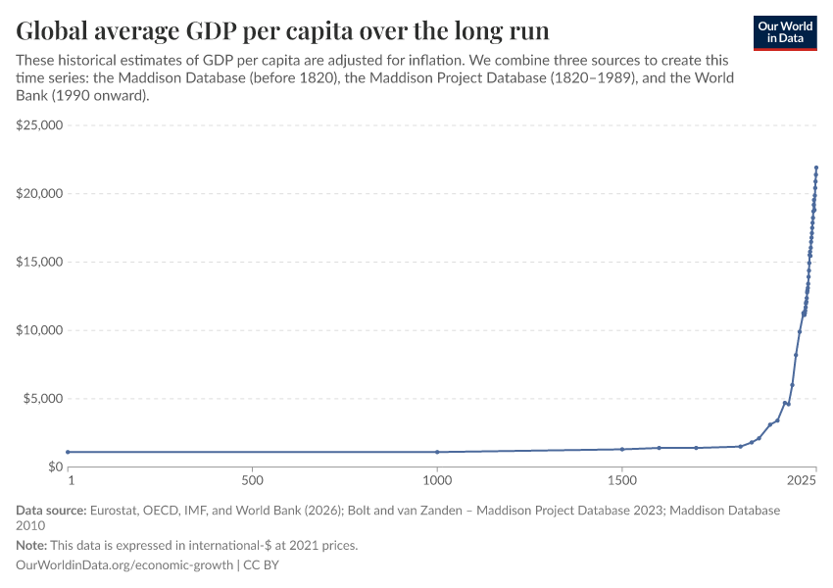
Organizational gains compound into large changes
EVIDENCE / OUR WORLD IN DATA
For most of history, average income changed slowly. The modern acceleration coincided with new technologies, firms, markets, and institutions.
The chart frames the scale of the organizational question; it does not identify a single cause.
Notes:
[Sources]
- Source content: /Users/shalliday/github/people-power-pay/private/Slides/Week01/week01_slides.pptx, source slide 13.
- Design reference: /Users/shalliday/github/people-power-pay/assets/css/ppp-rivera-v2.css and /Users/shalliday/github/people-power-pay/assets/css/quarto-nav-rivera-v1.css.
- Chart: https://ourworldindata.org/grapher/global-average-gdp-per-capita-over-the-long-run.
- Data source: Eurostat, OECD, IMF, World Bank (2026); Maddison Project Database 2023; Maddison Database 2010; processed by Our World in Data.
[/Sources]

Slide 34
Incomplete contracts create discretion—and power
CONTRACTS + POWER
No contract can specify and verify every future action.
Gaps are filled by authority, bargaining, routines, norms, or renegotiation.
Decision rights determine who can act as circumstances change.
Fallback options and asset control shape whose preferences prevail.
Power is the ability to decide, impose costs, and claim surplus.
34
Notes:
[Sources]
- Source content: /Users/shalliday/github/people-power-pay/private/Slides/Week01/week01_slides.pptx, source slide 24.
- Design reference: /Users/shalliday/github/people-power-pay/assets/css/ppp-rivera-v2.css and /Users/shalliday/github/people-power-pay/assets/css/quarto-nav-rivera-v1.css.
[/Sources]
[Sources]
- Milgrom, Paul, and John Roberts. Economics, Organization and Management, chapters 1–2, reproduced in AS.197.327 Week 1 Course Pack.
[/Sources]

Slide 35
WHAT WE CARRY FORWARD
1 OPEN THE BLACK BOX — Production functions hide authority and interaction.
2 LOOK FOR FIT — Strategy, information, incentives, routines, and technology reinforce one another.
3 COMPARE GOVERNANCE — Transaction attributes shape markets, relationships, and hierarchy.
4 ASK WHO DECIDES — Efficiency can predict survival without establishing fairness.
Notes:
[Sources]
- Source content: /Users/shalliday/github/people-power-pay/private/Slides/Week01/week01_slides.pptx, source slide 36.
- Design reference: /Users/shalliday/github/people-power-pay/assets/css/ppp-rivera-v2.css and /Users/shalliday/github/people-power-pay/assets/css/quarto-nav-rivera-v1.css.
[/Sources]
[Sources]
- Milgrom, Paul, and John Roberts. Economics, Organization and Management, chapters 1–2, reproduced in AS.197.327 Week 1 Course Pack.
[/Sources]

